Slide 1

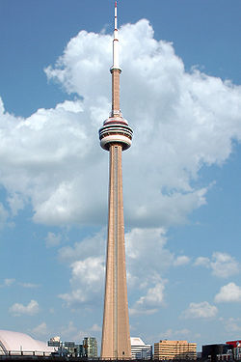
Build the tallest free standing tower
  Using only the limited materials provided in class
Work in teams of 4
  Make a plan before you cut!
  Discuss best use of your materials!
Pay attention to the Rules

Slide 2

Materials – No resupply or second chances
  One piece of ledger size paper,
  one pair of scissors,
  50 cm of tape
Limits
  Use only materials above
  Tower must be free standing
  Cannot be taped down
Timeline
  Planning 5 minutes
  Construction 25 minutes

Slide 3

You need a plan before collecting materials.
Your plan should include
  How you will cut & shape your paper
  How you will use your tape
  The members in your group
  A role / job for each member

Slide 4

Write down a 2 paragraph reflection on building the tower.
Suggested Topics (Paragraph 1):
  What are some good points about your design?
  What was useful to you understanding the instructions for the activity?
  How would you next time improve your design?
Suggested Topics (Paragraph 2):
  What roles did each of you play in your group to help accomplish the goal?
  What could you to improve your teamwork for this activity?

Slide 5


Slide 6

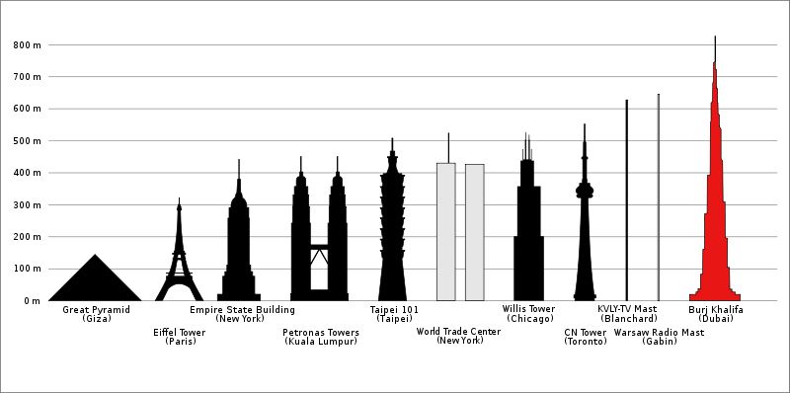
What is the tallest free standing structure on land today?

